Slide 1
Open University of Japan’s
Promotion of ICT in Education
Yoichi Okabe
Dean of the Open University of Japan

Slide 2
Outline
1. The Open University’s Situation
2. Interactive Learning（Use of Moodle）
3. SNS
4. OER
5. Conclusion

Slide 3
1. The Open University’s Situation
1.a. Present day Japanese Universities
1.b. What is the Open University of Japan?
1.c. Distance Education from an International Perspective

Slide 4
1.a. Present day Japanese Universities
Lack of effort in study by students←the result of intensive entrance exam prep
Graduating with limited academic ability←Universities required to maintain high graduation rates
Companies stating graduates’ ability has dropped
The search for jobs takes more time=>Even lower academic results
Poor positive feedback ensues
Even worse student communication ability

Slide 5
Can this be halted?
Make graduation exams more difficult (Make it harder to graduate)
  Initially this won’t be popular but can we afford not to?
Ensure interactive education occurs
  This will result in each university developing its own style
Ensure there are more chances for communication to take place
  Use of the Internet essential

Slide 6

1.b. What is the Open University?
No entrance exam. Difficult exams to graduate
All correspondence course lectures are publicly broadcast
Students are from a broad age range that follows the demographics of Japan – many older students
  Average age of students is 40~50, some are around 100
  The world’s most advanced LLL (Life Long Learning) Univ
  Learning centers in all prefectures – 50 or more in total
  Interview style lectures（二千余）＋Unit based exams＋Club involvement etc
  Still a lack of communication: Students, teachers
  Extra curricular activities are lacking as is library access
  Access from outer islands and Hokkaido is limited

Slide 7
Student age demographics

Slide 8
1.c. Distance Education from an International Perspective
Mega Univ. （Over 100,000 students）
  95% of the world’s mega Univ. are in Asia
ODL（Open Distance Learning） -> The ‘Internetization’ of ODL
  Radio、TV →ICT、Mobile technology
OER（Open Educational Resources ）
  Through the use of OER Universities don’t have to shoulder the financial burden

Slide 9
2. Interactive Learning
2.a. What is Interactive Learning(IL)?
2.b. The present state of IL
2.c. Problems with IL and their solutions

Slide 10

2.a.What is IL?
Asynchronous
  Questions are ‘Internetized’→email、forums
  Drill based learning resources
    The problems of correspondence based instruction are also ‘Internetized’（OU）
    Supply of reasonably priced learning resources（UPO）
Synchronous
  Webinar、Distance based lectures、Collaborative participation

Slide 11
2.b. The present state of IL
（OU）
The problem of correspondence based coursework（Moodle）
Online forums（Moodle）
Webinar
  Teachers who want to use them are already doing so
Distance education lectures、Collaborative participation
  Particularly Hokkaido and Okinawa are involved

Slide 12
Correspondence based instruction（ Moodle）on the Web

Slide 13
Online forums（Moodle）
Basically not very active
2010:When left to instructors, no increase in the number
2012: Without instructor participation almost no postings
2013: Planning to split them into two types – one with, one without instructor participation

Slide 14
2.c. Problems with IL and their solutions
Forums: When optional、difficult to promote student involvement（teachers also）
  ROM
  Enrolment timing varies thus postings become less timely
  Should they be compulsory?
  Include trained assistants（Increase student participation、take the place of teacher）
Forums: Awareness of “flaming” required
  Particularly in arts based courses
  Need to allow the deletion of posts, particularly when third parties become involved

Slide 15
3. SNS
3.a. Necessity of building Virtual Communities
3.b. Twitter
3.c. Facebook
3.d. Characteristics of SNS
3.e. Problems with SNS
3.f. SNS hereafter
3.g. SNS – are they really necessary?

Slide 16
3.a. Necessity of building Virtual Communities
OU（ODL）: Virtual Campus is necessary
Standard Univ: Youth like the Internet
When it is based on a LMS、participation in and of the university can mean a sense of community can be difficult to create
A free SNS is often easier to implement

Slide 17

3.b. Twitter
Aliases are common→a little irresponsible
Text less than 140 characters
Low privacy
High immediacy
A place of gossip for many __obake

Slide 18
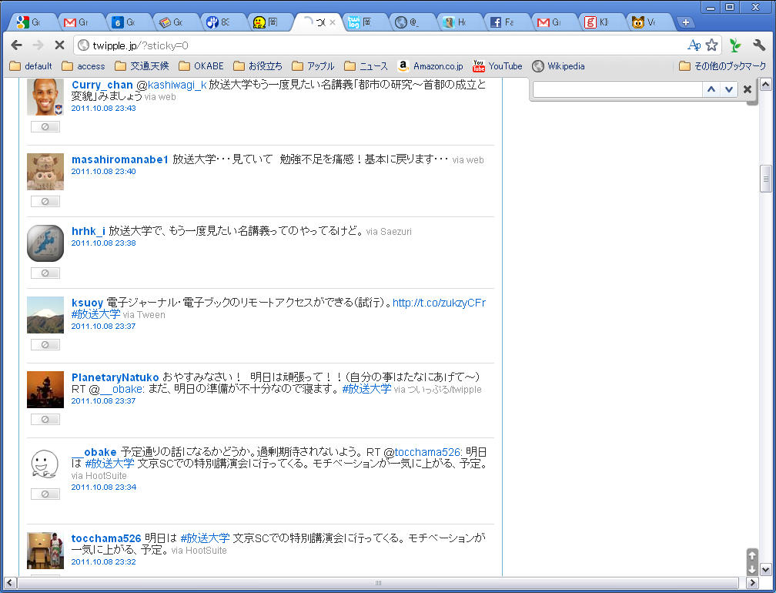

Slide 19
3.c. Facebook
Generally real names→More responsibility/ownership of material
Membership→A little more privacy
Easier to find online friends
Easy to form groups
Option of hidden postings
Club/circle based: like-minded people can join、Ease of discussion

Slide 20
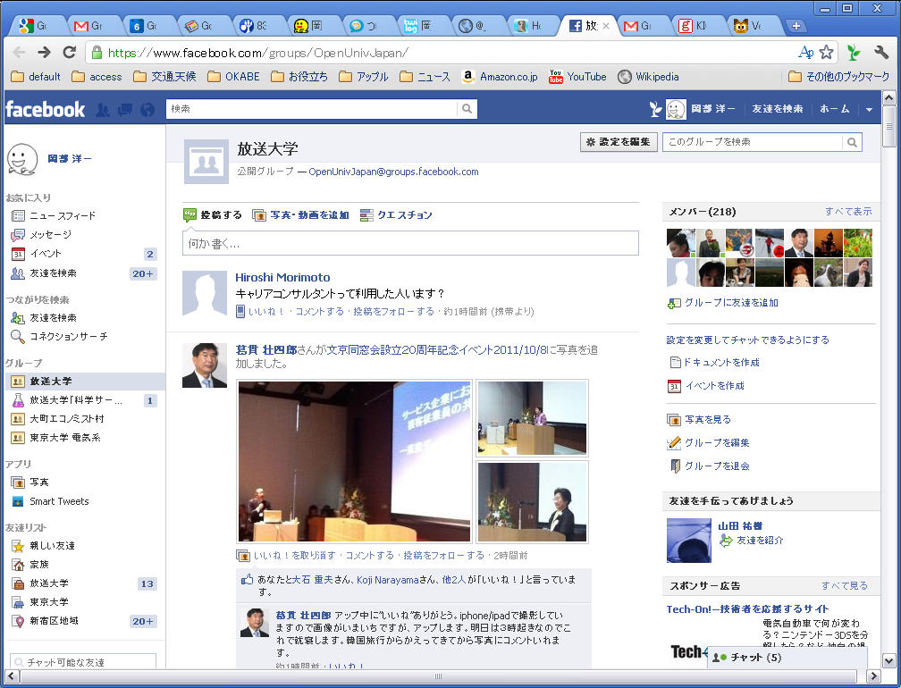

Slide 21
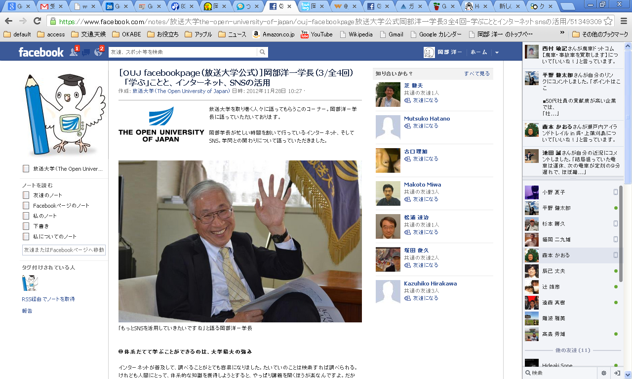
OU’s Official Facebook Page

Slide 22
3.d. SNS Features
There is enormous variety of uses of SNS
  Twitter:
    Easy to gauge opinions on OU
    Ease of reply, promotion function, News function
    Anonymous, so flaming can occur
  Facebook:
    Real names so discussion is more ‘real’
    Circles/clubs can be formed
    News function is limited

Slide 23
3.e. Problems with SNS
Flaming（Easy to occur on Twitter）
Hacking（This has occurred on an OU’s FB group page）
When there are a lot of people, different values clash and conflict can arise
Fixing the problems?
  Looking at the logs you can catch the culprit、However you need your own system→Moodle, Sakai etc

Slide 24
3.f. SNS hereafter
Though they are all SNS Twitter, Facebook, LinkedIn, Google+ ect、all have different uses and features – find the right one for you
To avoid flaming and for security purposes you should have access to user logs
As a tool for universities, they have enormous potential

Slide 25
3.g. SNS – are they really necessary?
They will become indispensible
The effect on education
  Student dissatisfaction less like to develop
  Future plans are accessible to students too
  Instructors have control over students
Effects on administrators
  Faster action
  Increased responsibility

Slide 26
4. OER
4.a. What is OER
4.b. Can they be profitable?
4.c. OER through OU
4.d. OER through the Internet
4.e. Digital text books
4.f. Some problems with OER and possible solutions
4.g. OER – a new trend

Slide 27
4.a. What is OER
Open Educational Resources
  MIT OpenCourseWare: Open lectures
  Open Learning Initiative (CMU): Open text books and resources
  distribution through OCW、iUniv、iTunes U etc.,
  MOOCs
Enthusiasm for these in the English speaking world
Universities using OER

Slide 28
4.b. Can they be profitable?
Costs a lot to produce but given for free
Use as advertising←As a business model, hasn’t had great success
For national and global economic interests there are benefits
As a contribution to society and in the national interest←Public investment can be sought
What do Univ’s using OER have to give back and how do they apply OER?

Slide 29
4.c. OER through OU
The OU model（Some 350 subjects covered）
Enormous expense in materials creation
News etc., that only OU can broadcast
Different countries have different agreements
  We can’t say you can use it “Anywhere, Anytime”

Slide 30
4.d. OER through the Internet
Making of these is relatively cost effective
  OU is moving to this model
Cannot use news content
Copyright etc. means it cannot be totally open→Only open to students
Generally borderless
  Anywhere, Anytime

Slide 31
Internet delivery Plan（OU）
%

Slide 32
4.e. Digital text books
OU: Digitalization of text books should be easy
  OU must have print versions of our texts
  We have just the one publisher（Foundation for the Promotion of The Open University of Japan）
Have not yet made a publisher’s business model
  For correspondence courses in 2013, parts of new print resources （60%、about ４０ sections）will be open on the Internet（First 3 chapters）

Slide 33
4.f. Some problems with OER and possible solutions
In Japan: Creative Commons is not really possible due to intellectual property rights
  streaming
  Use in mobile devices
  Should include museums etc. in this type of education promotion
Standard universities: Still unsure how to manage the various rights involved
OU: Content creation is from a broadcasting perspective、unsure of how to supply via the Net

Slide 34
4.g. OER – a new trend
MOOCｓ（Massive Open Online Courses）
No specified system but options for self study in an interactive manner are many
  One example is drill based learning
  Another is debate at a specific time
Certification at course end
Can’t see this as a long term business model
For the moment, there are major costs that are carried by the business partners

Slide 35
Advantages Universities have over MOOCs
  Can supply excellent instructors
  Able to supply facilities for experiments etc.
  Give students more opportunities to communicate
  Certified courses、and accumulation of these results in degree conferment

Slide 36
Can universities maintain the advantage?
  MOOCs can survive with just a few excellent instructors
    They have greater leeway with instructors’ retirement
    Market based→Good courses are markedly so
  Expensive but simulated experiments are available
    In electrodynamics etc. simulations have major advantages
  Virtual campuses are options
  Society may come to view completion of truly excellent courses as equivalent to degrees

Slide 37
With the slogan of “Internationalization” comes growing appreciation of English content courses
Deterioration of University standards→ Lose of prestige of the “graduate” status
The difficulties universities have in remaining “cutting edge”
Open universities understand the potential of ICT but also know the dilemmas it brings
  Watch carefully for future developments

Slide 38
5. Conclusion
1. With ICT’s advance technical and system problems have diminished （though how mobile devices will develop is another matter）
2. Instructors and students are being encouraged to use it
3. There are still many intellectual property rights problems
4. SNS: Increasingly necessary
5. OEは今後の大学の一つの方向性かも
一方で既存大学の危機になるかも

