Slide 1
MoodleMoot Japan 2018 – Musashi University
Balancing Real-time Feedback
vs. Recorded Assessments Using Moodle Rubrics
Finding the Balance :
Timing, Tools and Teaching (TTT?)
Matt Cotter
Hokusei Gakuen University
Don Hinkelman
Sapporo Gakuin University

Slide 2
Presentation Performance
Notes:
Kate

Slide 3
Interview Performance
Notes:
Kate

Slide 4
Group Performance

Slide 5
Role Play/Drama Performance
Notes:
Kate

Slide 6
PRINCIPLE 1
Assessment
of *for* learning
Assessment *of* learning
for testing/administration
Gardner, J. (2012)
Notes:
Kate

Slide 7
PRINCIPLE 2
‘Endless’ feedback in formative assessment
“Learners need endless feedback more than
they need endless teaching.”
(Wiggins, 2012)
Wiggins, G. (2012a). “Less teaching and more feedback?” ASCD in Service. Accessed from: http://inservice.ascd.org/less-teaching-and-more-feedback/
Wiggins, G. (2012b). “Seven keys to effective feedback” Educational Leadership, 70(1), pp. 10-16.
Notes:
Kate
Feedback is defined as “actionable comments and coaching timed to affect maximum behavior change” (Hinkelman, 2017)

Slide 8
methodology
Collaborative action research
(8 year longitudinal study in one Japanese university)
Oral English Presenting Class – 5 Presentations (One semester)
2010 - experimented with syllabus design; types of assessment
2011 - added video recording, hosted on YouTube, LMS forums
2012 - designed new LMS module for video assessment
2013 - added self and peer assessment
2014 - evaluated self/peer assessment
2015 - added whole class synchronous assessment
2016 - trialed whole class synchronous assessment
- added rubric pre-calibration
2017 - synchronous, in class teacher coaching focus
Notes:
Don

Slide 9
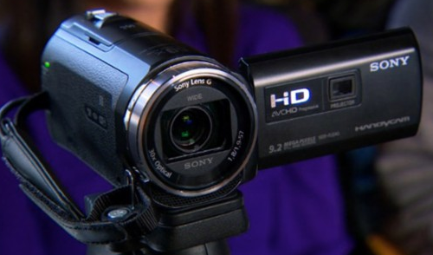
methodology
Start 2010 - experimented with syllabus design
types of assessment
2011 - added video recording
hosted on YouTube
trialed LMS forums
Post Performance
Feedback
1.
=
Notes:
Don

Slide 10
2012 - designed new LMS module for video assessment
2013 - added self and peer assessment
2014 - evaluated self/peer assessment
2015 - added whole class synchronous assessment
2016 - trialed whole class synchronous assessment
- added rubric pre-calibration
Post Performance
Scoring &
Feedback
(self, peer, teacher)
＋
=
Notes:
Don

Slide 11
1. Video presentation
What is the Moodle Video Assessment Module?
“Hi everyone. Today I’m going to talk about cute stuff!”
2. Upload to PC
Notes:
Matt

Slide 12
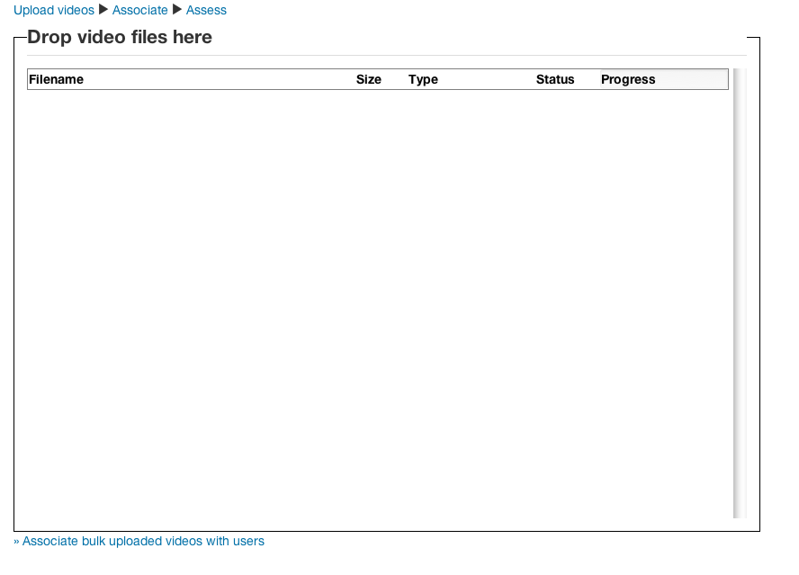
3. Upload from PC to Moodle
4. Associate Video with student
Notes:
Matt

Slide 13
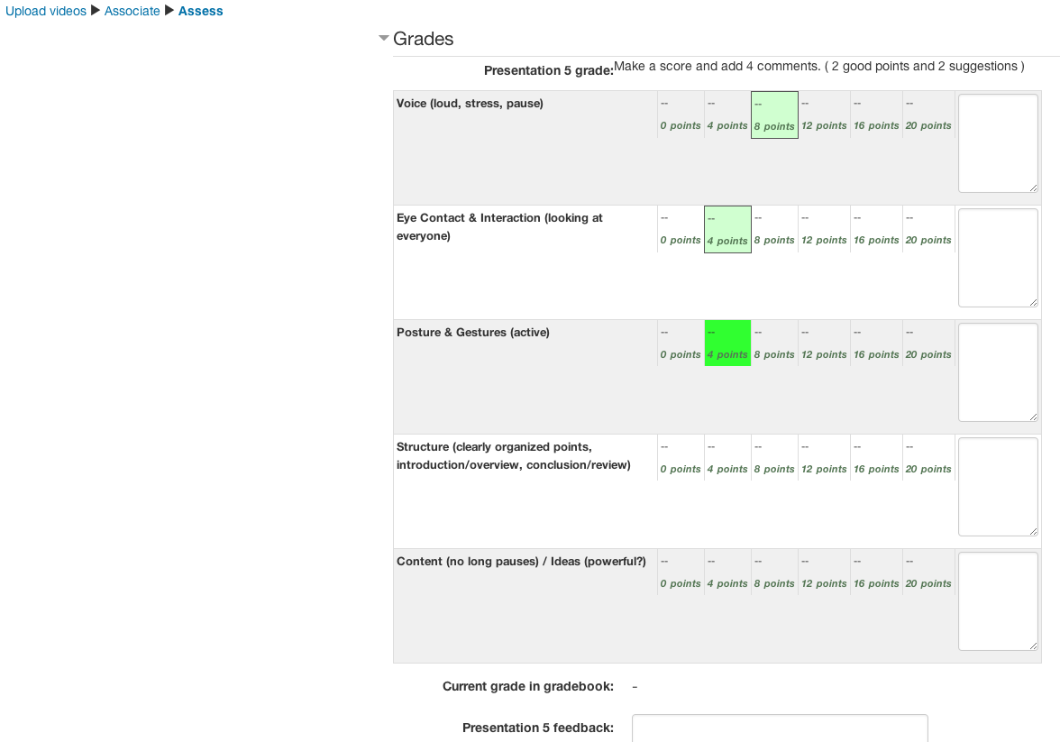
5. Assess the Presentation
Score
Comments
Teachers and students watch videos and assess themselves and/or peers on simple/complex predetermined rubric criteria.
Notes:
Matt

Slide 14
Video assessment module - In use
Notes:
Matt

Slide 15
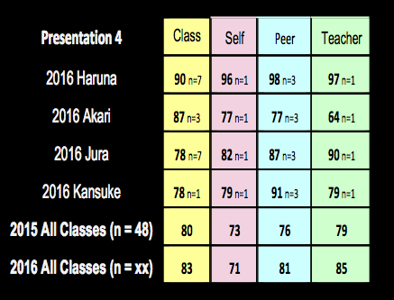
PRELIMINARY RESULTS 2016 Quantitative
Notes:
Don

Slide 16
Findings (until 2016)
Quantitative
Students rated themselves lower than peers and
teachers.
Peers scored almost the same as teachers.
Students scores are closer to teacher scores during post assessment.
Student scores are higher when scoring in real time.
Qualitative
Students valued the assessment task.
Students valued teacher feedback over peer and
self feedback but still valued peer feedback.
Students would rather be assessed than assess.
Notes:
Don

Slide 17
Questions from findings
1) Was the load too big for the students?
Students spent a lot of time doing 4 out of 5 presentation post assessments on Moodle
(including new pre-training calibration
2) Were students were taking the
process seriously?
Most assessing tasks were done out of
class time for homework

Slide 18
2017
Asynchronous, post-performance feedback
＋
a little!
(Only 2 out of 5 presentations)
Synchronous, in class teacher coaching!
“Stop! Say it this way! More eye contact! Stress that word, it is important! ……”
a LOT!
4 out of5 presentations
Notes:
Don

Slide 19
Qualitative Data focus group & teacher’s forum
Key Research Questions:
What types of assessment and feedback are we doing?
How often are we doing it?
What did students actually do?
What did students say at the end of the course?
Deferred Research Question:
What types of assessment and feedback are most effective?

Slide 20
Qualitative Data focus group & teacher’s forum
Teacher C:
“I often heard the words, “緊張していた”, meaning ‘kinchou shite ita’, or ‘I was nervous’, but often with a look of accomplishment. I told them conquering nervousness was the number 1 aim, and they will be able to claim this skill when they are job hunting.”

Slide 21
Qualitative Data focus group & teacher’s forum
Teacher C: What is coaching?
“There is spectrum of:
Teaching
Interacting
Demonstrating
Commenting
Interrupting
…. that makes up coaching..”

Slide 22
Qualitative Data focus group & teacher’s forum
2. Interacting

Slide 23
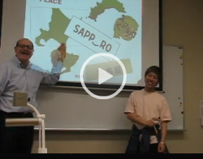
Qualitative Data focus group & teacher’s forum
3. Commenting
http://moodle.sgu.ac.jp/mod/videoassessment/view.php?id=70900&action=assess&userid=14253

Slide 24
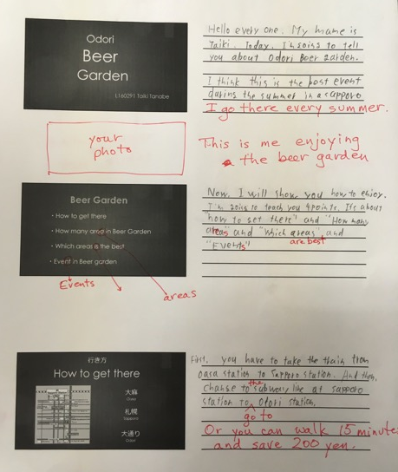
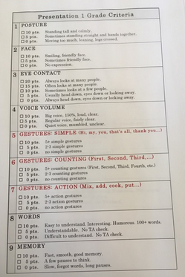
Qualitative Data focus group & teacher’s forum
Summary: 1) Scripting 2) Good/bad Demo

Slide 25
Questionnaire Results (n=48)
Watching

Slide 26
Questionnaire Results (n=48)
Rating (Scoring)

Slide 27
Questionnaire Results (n=48)
Feedback

Slide 28
Questionnaire Results (n=48)
Teacher
Tool

Slide 29
Questionnaire Results (n=48)
Teacher
Tool

Slide 30
Limitations and plans for 2019
Should separate Q3. in questionnaire…..
Synchronous
(Real Time)
or
Asynchronous (Post-Performance)
Find the right balance between timing, tools and teaching!

Slide 31
There is no one method!
Find the balance!
Notes:
Everyone

Slide 32
Real-Time vs Post-Performance of English Presentations
CALLPlus 2017
Saturday, October 28
Matt Cotter
(Hokusei Gakuen University)
Don Hinkelman
(Sapporo Gakuin University)
Notes:
Kate

Slide 33
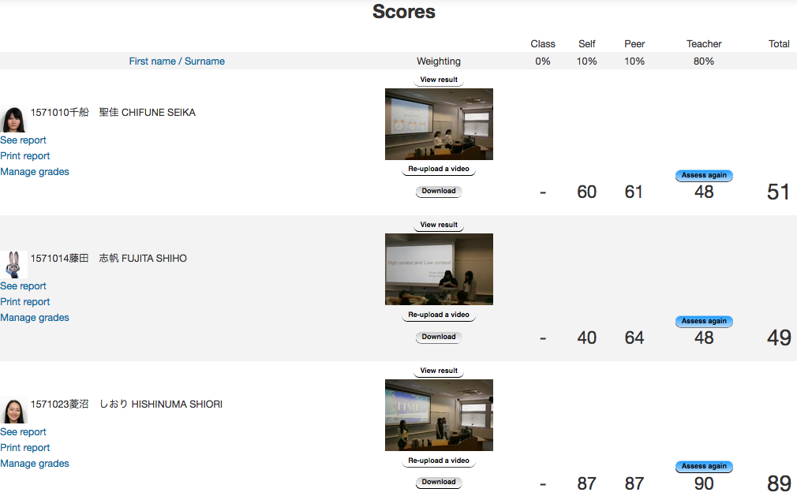
Video assessment module - practical Use
Intercultural Communication
Assessment : Pair English Presentations IC Topic
Key Point : Upload videos twice – for each presenter
Notes:
Matt

Slide 34
Maori Performance

Slide 35
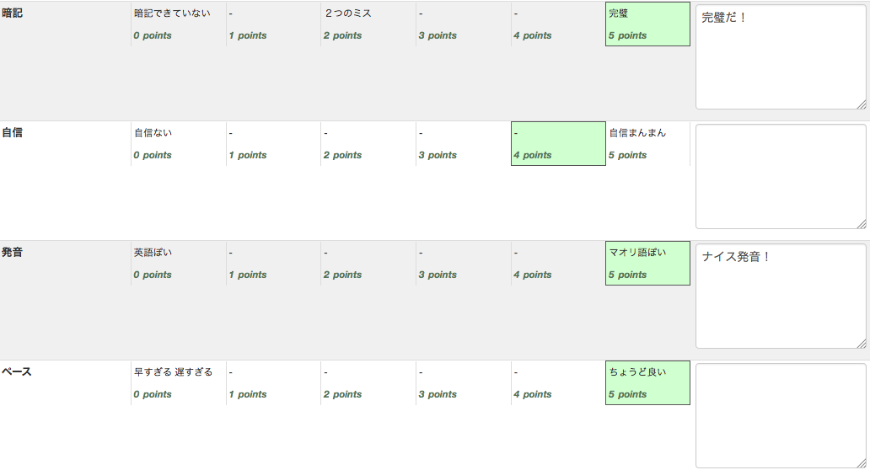
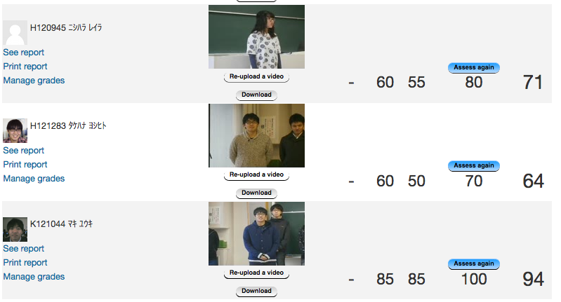
Video assessment module - practical Use
Maori History, Culture and Present Day Status
Assessment : Self Introduction in Maori Language
Key Point : Simple Rubric, Rubric in L1 (Japanese)
Notes:
Matt

Slide 36
English Through Sports Performance

Slide 37
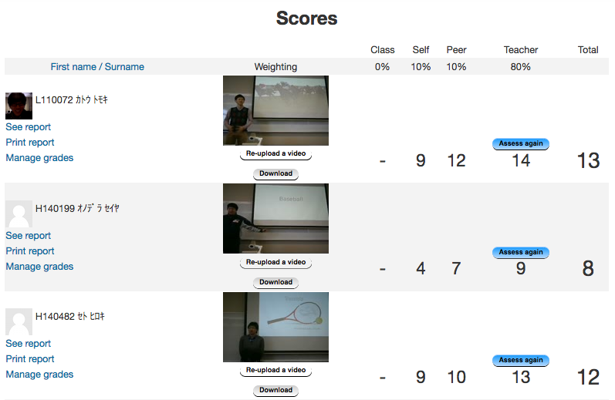
Video assessment module - practical Use
English Through Sports
Assessment : English Presentation of a Skill or Technique
Key Point : Action and English skill assessed
Notes:
Matt

Slide 38
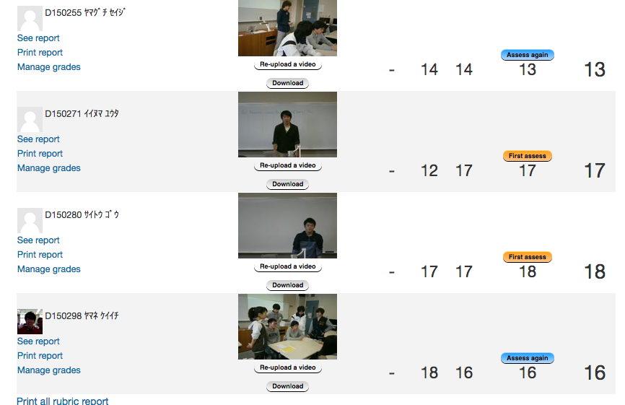
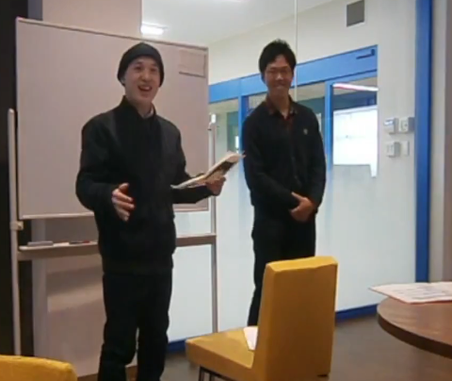
Video assessment module - practical Use
Child Development
Assessment : Self, peer and one teacher assessing each student
Key Point : Asynchronous blind marking - comprehensive rubric
Notes:
Kate

Slide 39
Early English Teaching Performance

Slide 40
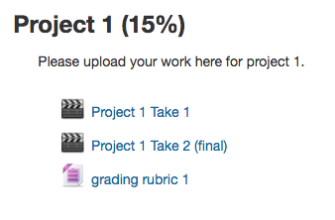
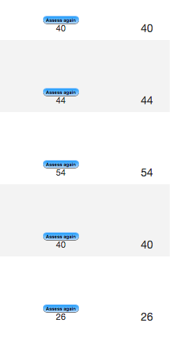
Video assessment module - practical Use
Expression
Assessment : Teacher assessment & self-reflection - shows improvement.
Key Point : Each assessment repeated after self-reflection
Reassessed for improvement using same rubric
Notes:
Kate

Slide 41
Real Time assessment!!
NEW!!
TRIALLED THIS YEAR!!
Notes:
Kate

Slide 42
Real time assessment why?
NEW!!
Can real time assessment provide further training in the assessment process?
Can real time assessment do just as good a job as post-performance assessing?
Can real time assessment help the learning process – What are important/not important criteria for performances?
Notes:
Kate

Slide 43
Real time assessment How?
Students use a portable device (smartphone /
tablet) to access the module and choose the
presenter’s user name.
While listening and watching the presentation, the
students score the criteria on the rubric.
(Our presentations were too fast to make comments -
although this could be done with longer performances.)
Notes:
Junior

Slide 44
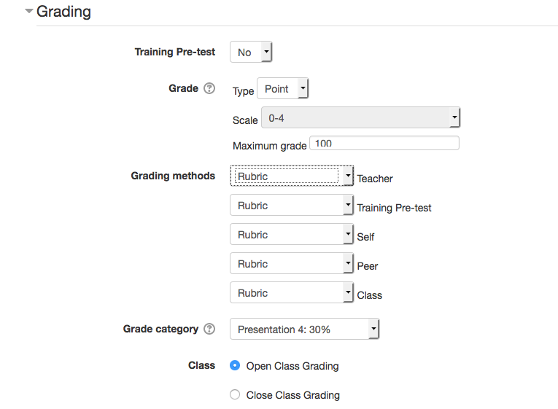
Real time assessment set up
Notes:
Junior

Slide 45
PRELIMINARY RESULTS 2016
Notes:
hidden

Slide 46
MOODLE VIDEO ASSESSMENT MODULE - A BRIEF OVERVIEW -
How it works!
Notes:
Matt

Slide 47
Real Time assessment!!
NEW!!
TRIALLED THIS YEAR!!
Notes:
Kate

Slide 48
Real time assessment why?
NEW!!
Can real time assessment provide further training in the assessment process?
Can real time assessment do just as good a job as post-performance assessing?
Can real time assessment help the learning process – What are important/not important criteria for performances?
Notes:
Kate

Slide 49
Real time assessment How?
Students use a portable device (smartphone /
tablet) to access the module and choose the
presenter’s user name.
While listening and watching the presentation, the
students score the criteria on the rubric.
(Our presentations were too fast to make comments -
although this could be done with longer performances.)
Notes:
Junior

Slide 50
Video assessment module - practical Use
All English Speech Contest
Assessment: Synchronous (3- 4 people)
Using ipads
Real time
Pair presentation
Clear rubric
Key Point: Results
Instantly collated on Moodle
All results on one page
Transparent
Notes:
Junior

Slide 51
Video assessment module - practical Use
Seminar Class
Assessment :
Rubric based on students’ recipes
Methodology of making coffee (practicum)
Team work
Team feedback to own team
Individual roles within each team
Use of language
Key Point :
Videos taken on students phones
Videos uploaded by students
Teacher and peer assessment
Potential for using the calibration
Notes:
Junior

Slide 52
methodology
Collaborative action research:
(Eight year longitudinal study in one Japanese university)
Oral English Presenting Class – 5 Presentations (One semester)
Cycle ①: 2010 - experimented with syllabus design; types of assessment
Cycle ②: 2011 - added video recording, hosted on YouTube, LMS forums
Cycle ③: 2012 - designed new LMS module for video assessment
Cycle ④: 2013 - added self and peer assessment
Cycle ⑤: 2014 - evaluated self/peer assessment
Cycle ⑥: 2015 - added whole class synchronous assessment
Cycle ⑦: 2016 - trialed whole class synchronous assessment
- added rubric pre-calibration
Cycle ⑧: 2017 - synchronous, in class teacher coaching focus
Notes:
Don

Slide 53
NEW!!
NEW FEATURE 2016
Pre-calibration: What does it do?
Online training session
Students need to align their scoring ability with the teacher’s ability.
Students watch a video, score it, are given immediate feedback.
Re-do if +20% off teacher criteria scores.
Notes:
Don

Slide 54
NEW FEATURE 2016
Piloting of Pre-calibration
Problems
Students can see the teacher’s answers.
Video performance used in pre-calibration was too easy to guess. It needs several missing or poor points in the performance.
Students are locked into it and cannot proceed to self-assessment due to a bug.
Notes:
Don

Slide 55
PLANS FOR 2017
Action Research Cycle 8
Pre-calibration de-bugging
Trials in multiple schools
Documentation and ‘Help Buttons’
Larger class sizes—practical operation test
Paper printouts of total assessment, reflection by students
More in-class coaching (synchronous voice feedback)
Notes:
Matt

Slide 56
PRELIMINARY RESULTS 2016 Qualitative
Students do a better job at peer assessment, when they look at a recording (the Peer numbers were closer to teachers ratings than the Class numbers). This suggests that no time pressure is a factor.
When students do live rating (Class), they are less discriminating. Tend to score higher, but they do score a little lower when they see a poorer presentation. So scores are better than random.
Some individual criteria were scored wrong, maybe because students did not understand that criteria (i.e. Personalised)
Notes:
Don

Slide 57
CONCLUSION 2016
Class rating should have lowest percentage in scoring weightings! (5% or possibly 0%)
But it has two important functions :
Training in scoring rubric criteria
Focusing attention during presentations.
Notes:
Don

